Slide 1
Introduktion til Programmering og Problemløsning (PoP)
Jon Sporring
Department of Computer Science
2020/09/07

Slide 2
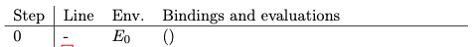
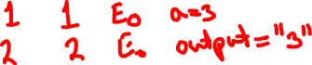
Håndkøring (tracing)
simple.fsx
1 let a = 3
2 printfn "%d" a

Slide 3
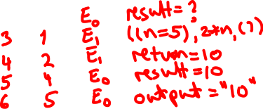
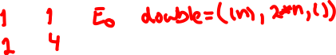
Håndkøring (tracing)
function.fsx
1 let double n =
2 2*n
3
4 let result = double 5
5 printfn "%d" result

Slide 4
Håndkøring (tracing)
loop.fsx
1 let printDoubles n =
2 for i = 1 to n do
3 printf "%d " (2*i)
4 printfn ""
5
6 printDoubles 3

Slide 5
Håndkøring (tracing)
loopUnfolded.fsx
01 let printDoubles n =
02 // Unfolding assuming n = 3
03 // for i = 1 to n do
04 // printf "%d " (2*i)
05 (
06 let i = 1
07 printf "%d " (2*i)
08 )
09 (
10 let i = 2
11 printf "%d " (2*i)
12 )
13 (
14 let i = 3
15 printf "%d " (2*i)
16 )
17 printfn ""
18
19 printDoubles 3

Slide 6
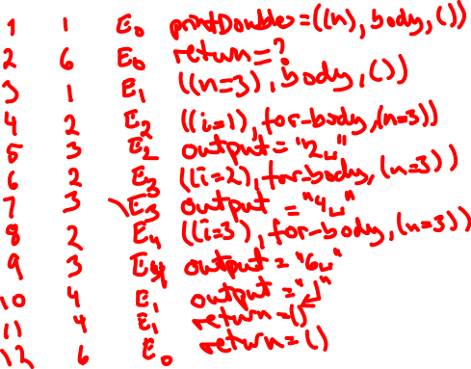
Håndkøring (tracing)
loop.fsx
1 let printDoubles n =
2 for i = 1 to n do
3 printf "%d " (2*i)
4 printfn ""
5
6 printDoubles 3

Slide 7

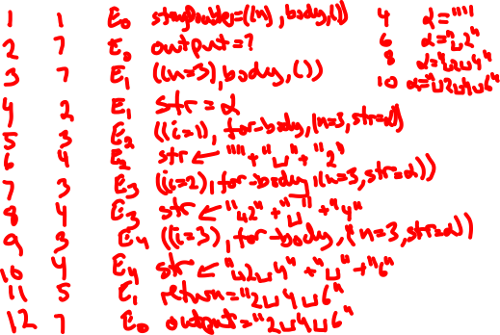
Håndkøring (tracing)
loopMutable.fsx
1 let stringDoubles n =
2 let mutable str = ""
3 for i = 1 to n do
4 str <- str + " " + string (2*i)
5 str.[1..]
6
7 printfn "%s" (stringDoubles 3)

Slide 8
Resumé
I denne video hørte du om:
Håndkøring (tracing)
Simpelt program
Funktion
Løkke
Variable

